Slide 1
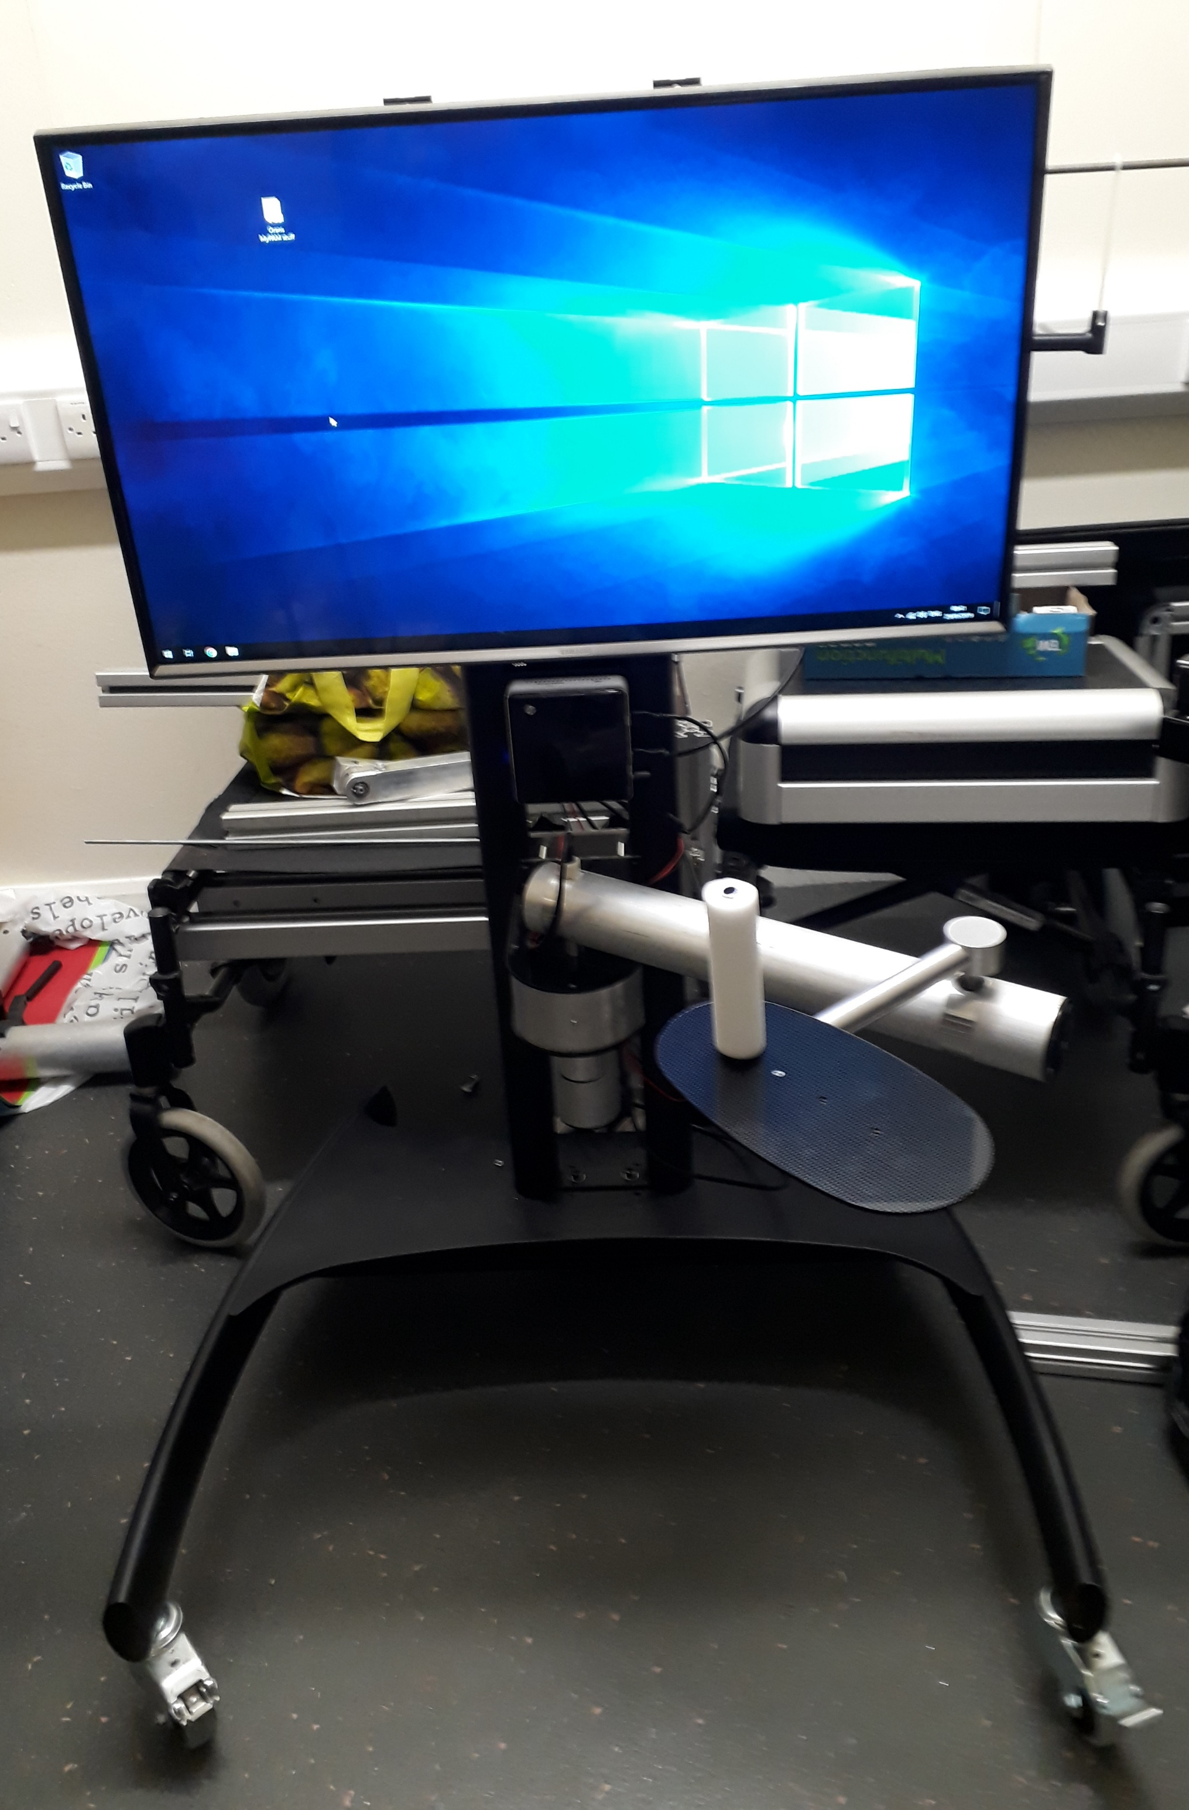
Game Screen
Powered joint 0
Powered joint 1
Handle

Slide 2
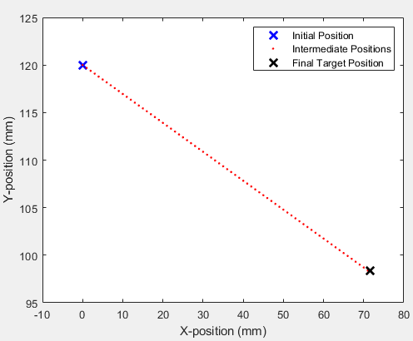
Direction
of travel

Slide 3
i
ii
iii
iv
EcoFlex 0010
EcoFlex 0050
EcoFlex 0010
EcoFlex 0050

Slide 4
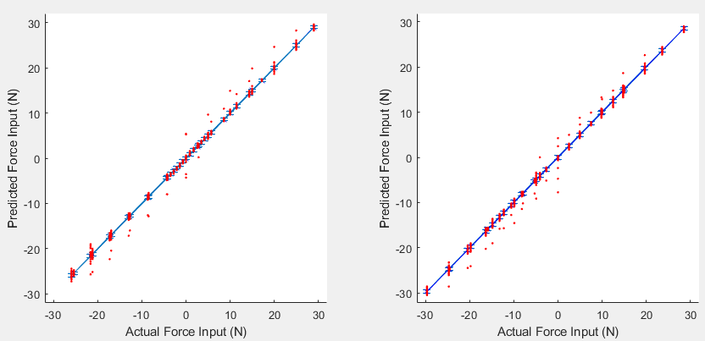

X-component of Force
Y-component of Force

Slide 5
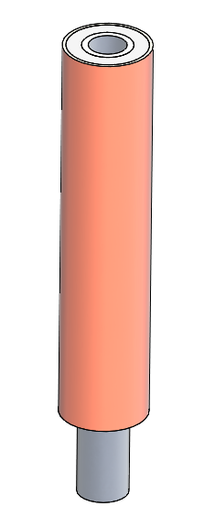
Hyperelastic Silicon
= North face
= South face
Rigid Outer Core
Rigid Outer Core
Hall Effects Sensor
Neodymium Magnet
Neodymium Magnet
Rigid Inner Core
Hyperelastic Silicone
Rigid Inner Core

